Slide 1
BANKING MANAGEMENT SYSTEM
Submitted by-
Asha peddinti
Batch(2021-6258)
Banglore

Slide 2


Slide 3
This java program has following main menus:
1.Display All
2.Search By Account
3.Deposit
4.Withdrawal
5.Exit

Slide 4
Initially, we will add some (N) customers to the bank and then we can display all account details using these steps-
menu1-display all account details
menu 2-used to search the bank account
menu 3-used to deposit money in particular account
menu 4-used to manager withdrawal and
menu 5-is used to exit from the program.

Slide 5
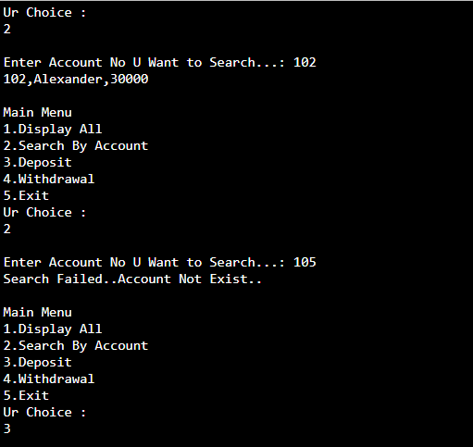
Output:

Slide 7
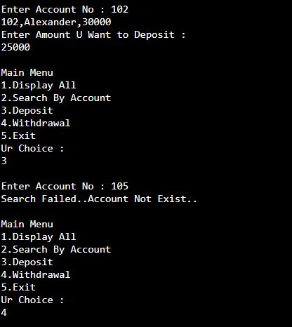

Slide 8
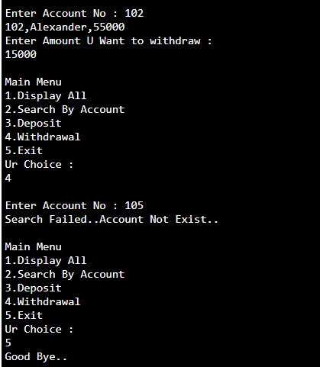

Slide 9


